Slide 1
Practice of ELT
METHODOLOGY
ELT TEACHER TRAINING
BY TARIK İNCE

Slide 2


Slide 3

A - The Place of English
English has become a lingua franca.
Lingua franca is used for communication between two speakers whose NL are different.
Today English is one of the main languages for international communication.
How English Got There
A colonial history: America, Australia, India
Economics: The emergence of the USA as a world economic power; globalisation
Travel: travel and tourism; airports; air traffic control and sea travel communication
Information Exchange: academic discourse, articles, conferences; the internet
Popular Culture: pop music; TV; cinema
Where English Fits / The Future of English
Is English used for cultural imperialism or not?
It is most unlikely that English will ever become the dominant language in the world.

Slide 4
B – Varieties of English
Like other languages, English can take many forms.
There are differences in pronunciation, vocabulary and grammar
British English, American Englis, Australian English, Hispanic English, Chinese English
Three Circles (the division of English speaking world)
Inner Circle – countries where English is spoken as a first language. (Britain, Canada)
Outer Circle – English is spoken as a second or significant language ( India,Singapore)
Expanding Circle – English has cultural or commercial importance (China, Japan)
In a world of so many Englishes, we have to consider which variety to teach.
Ts should expose sts to different language varieties.
This will help Sts when they come into contact with different language varieties.
Level is very important in exposure to different varieties.
decide whether the English we teach our Sts will be general or specific.
General: all-purpose language with no special focus on one area.
Specific (ESP):English for Academic Purposes (EAP),
English for Science and Technology (EST)

Slide 5
Unit 2 DESCRIBING
LANGUAGE

Slide 6
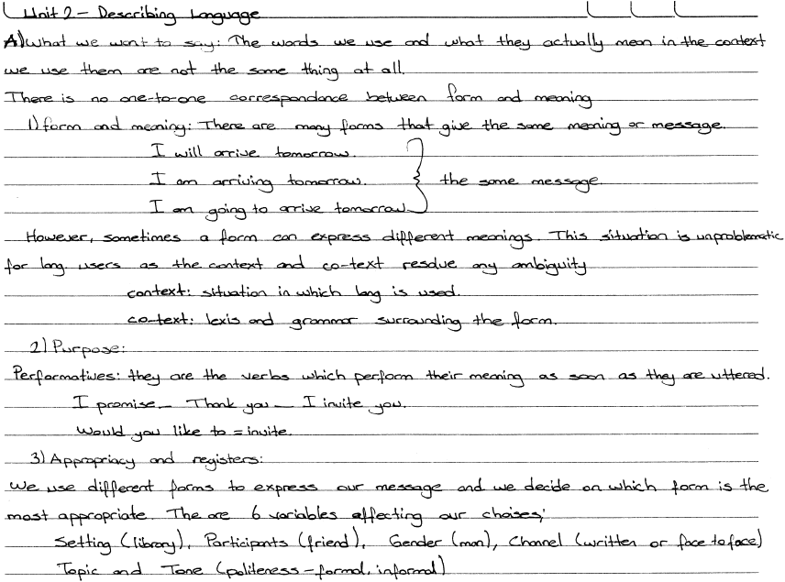
Unit 2 DESCRIBING LANGUAGE

Slide 7
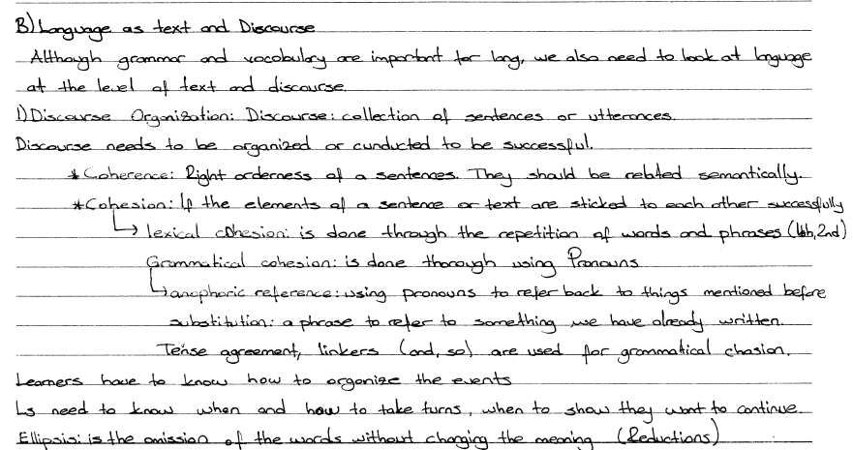

Slide 8
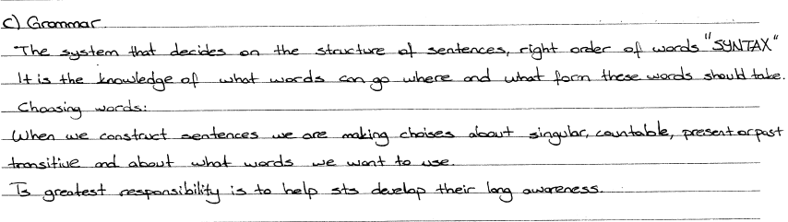

Slide 9
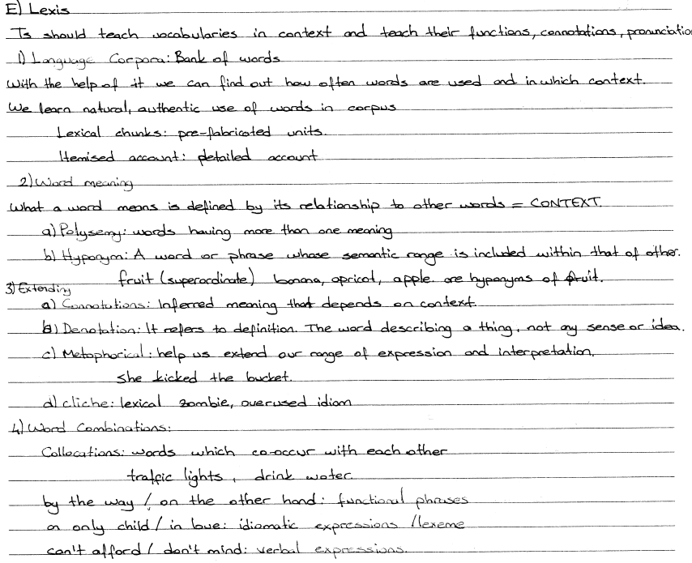

Slide 10
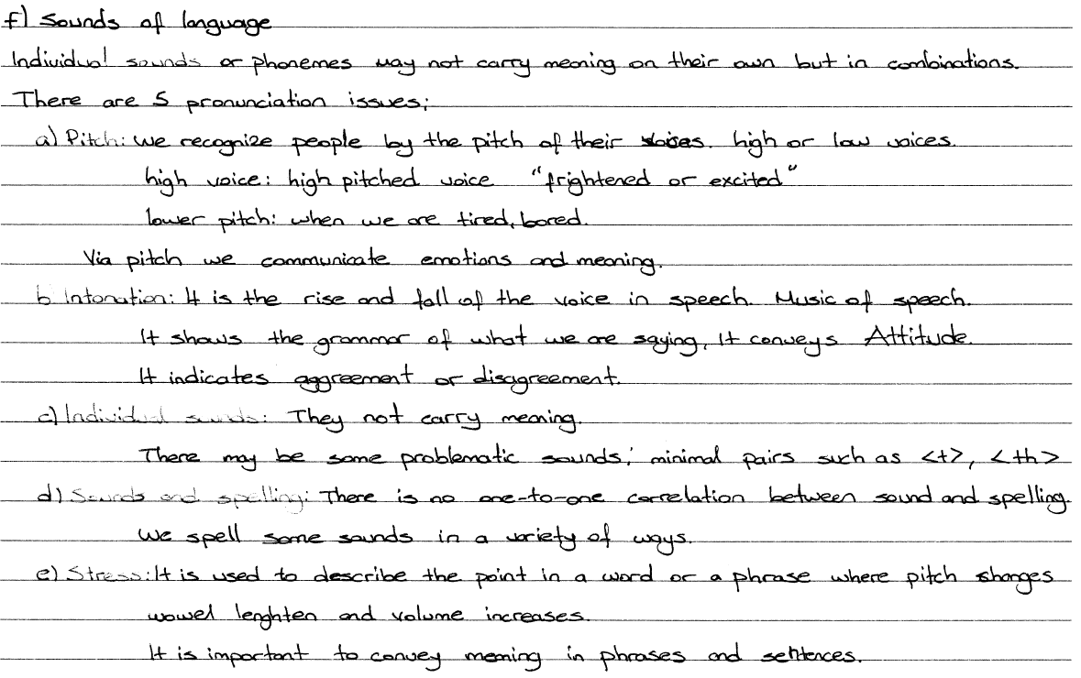

Slide 11
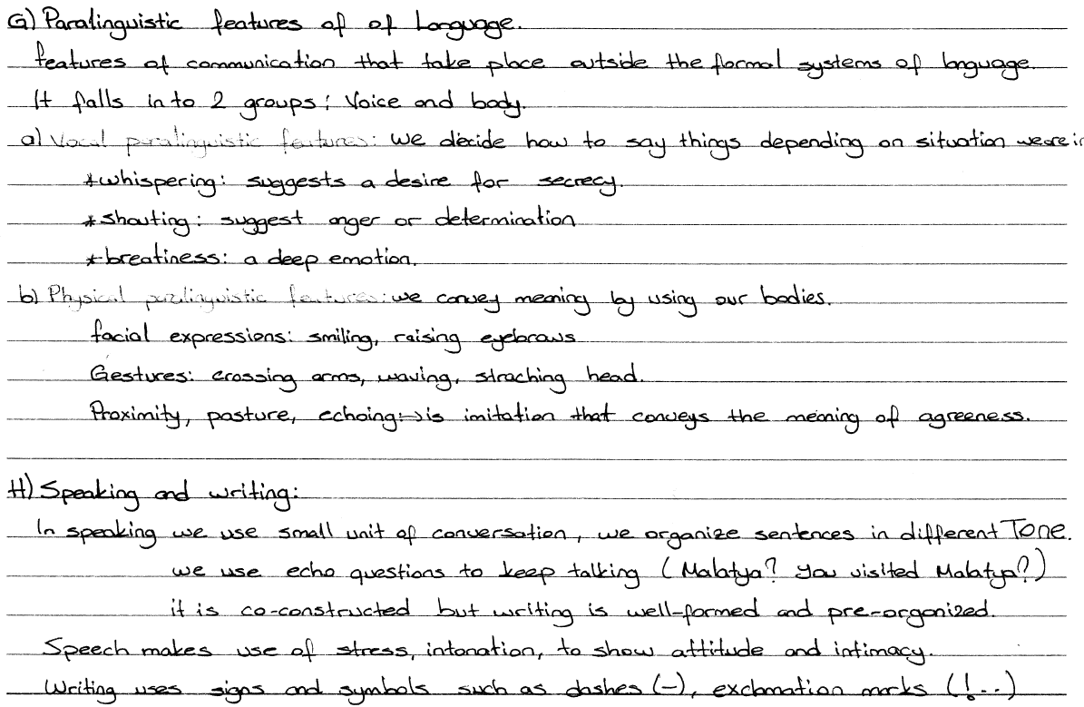

Slide 12
Unit 3 BACKGROUND ISSUES in LANGUAGE LEARNING

Slide 13
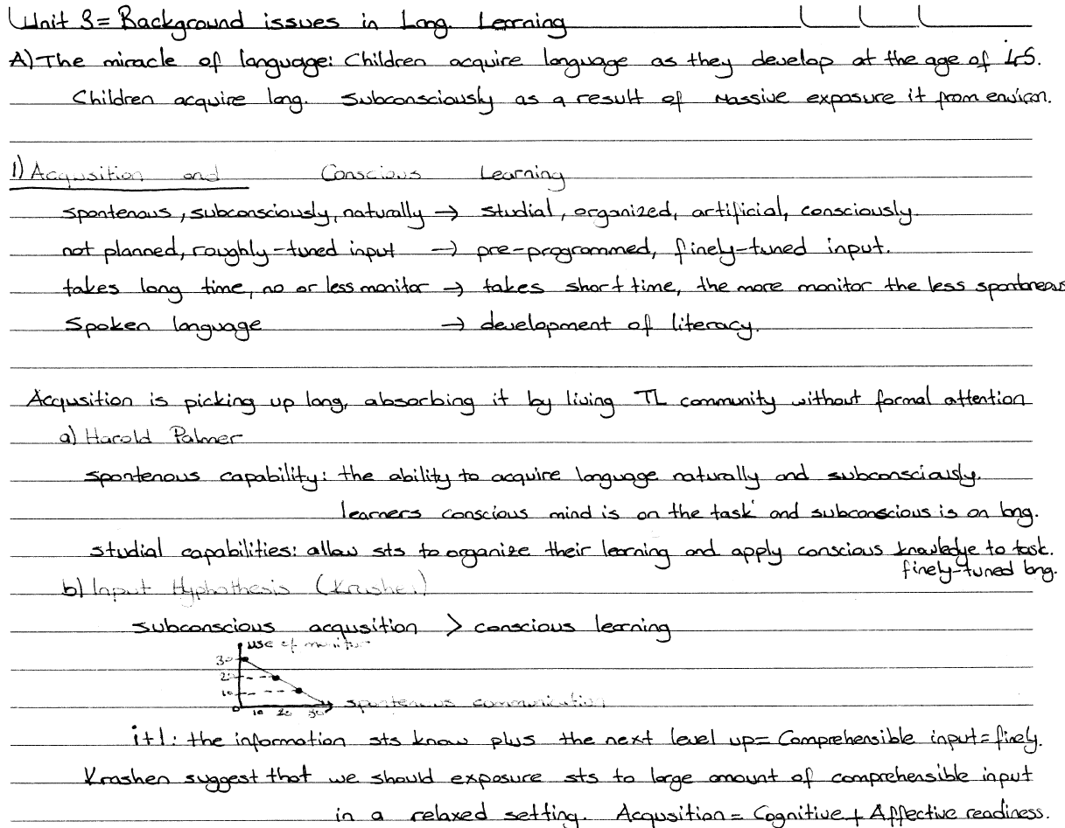
Unit 3 BACKGROUND ISSUES in LANGUAGE LEARNING

Slide 14
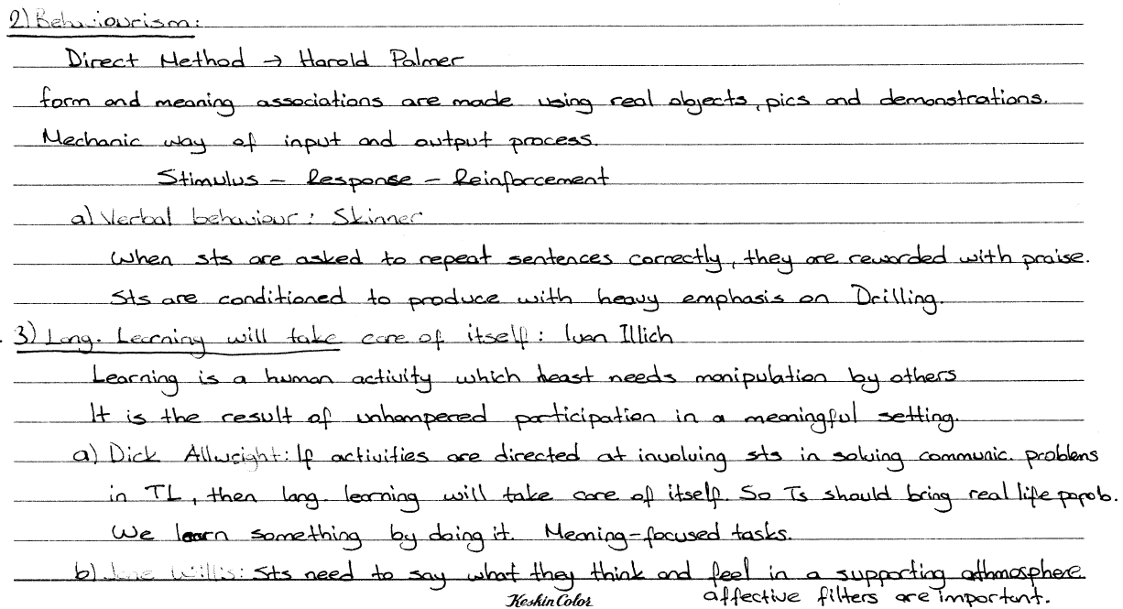

Slide 15
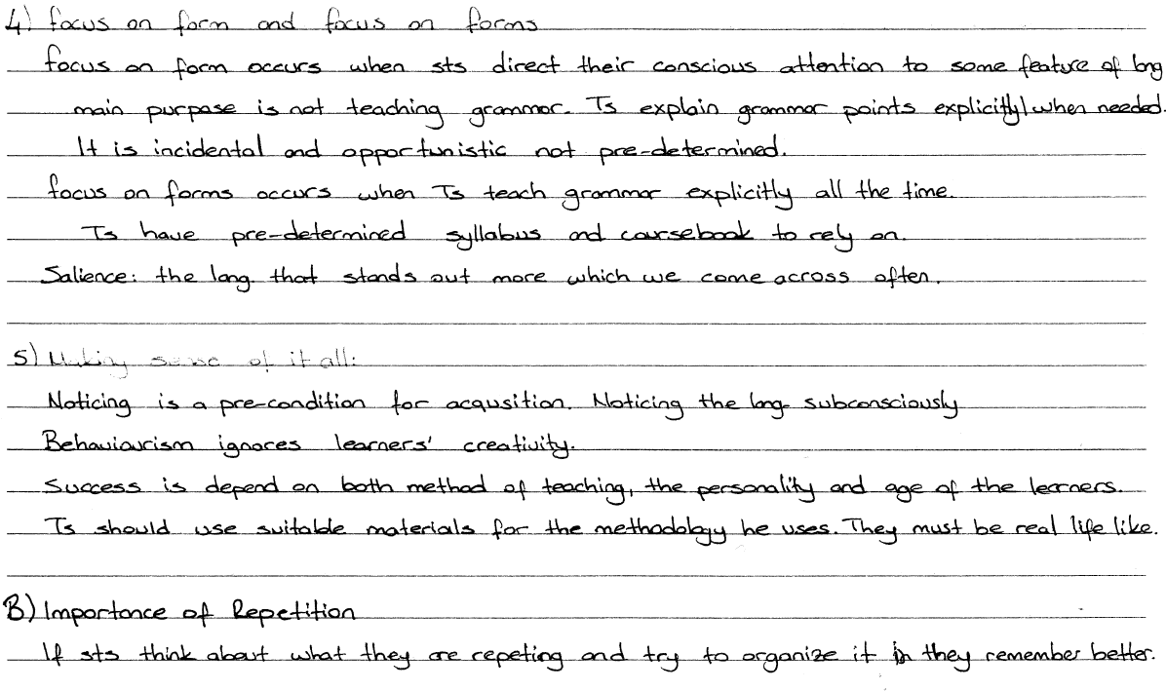

Slide 16
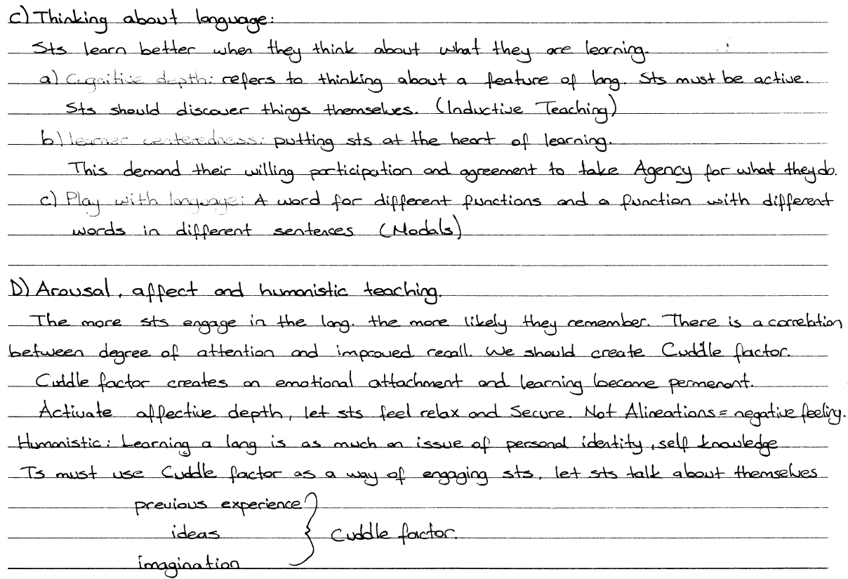

Slide 17
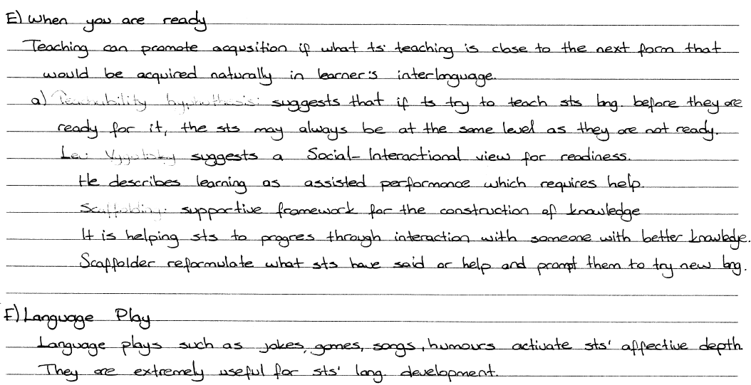

Slide 18
Unit 4 POPULAR METHODOLOGY

Slide 19
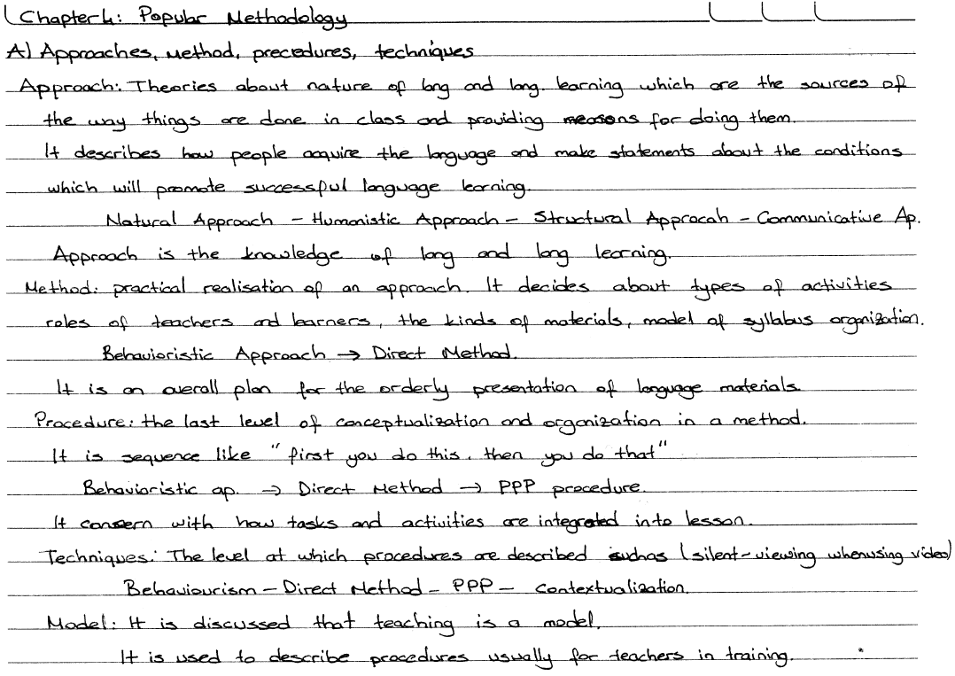
Unit 4 POPULAR METHODOLOGY

Slide 20
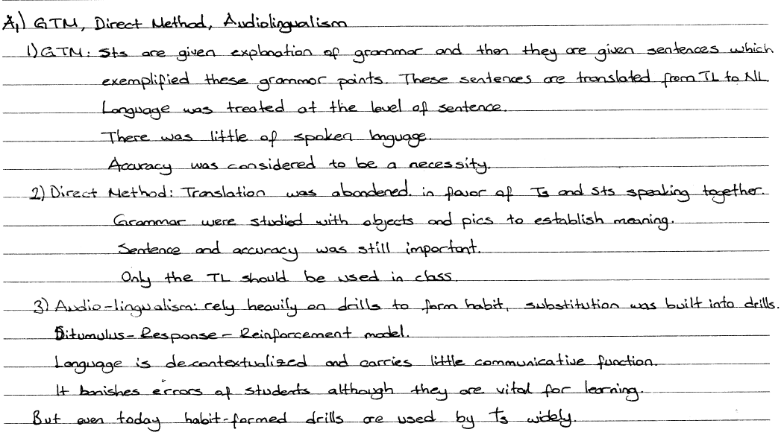

Slide 21
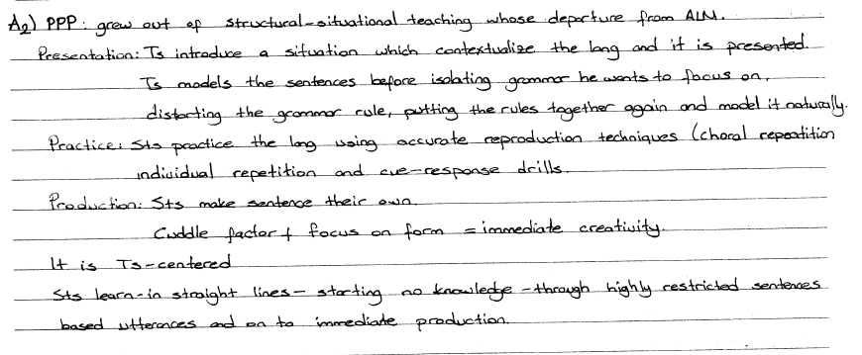

Slide 22
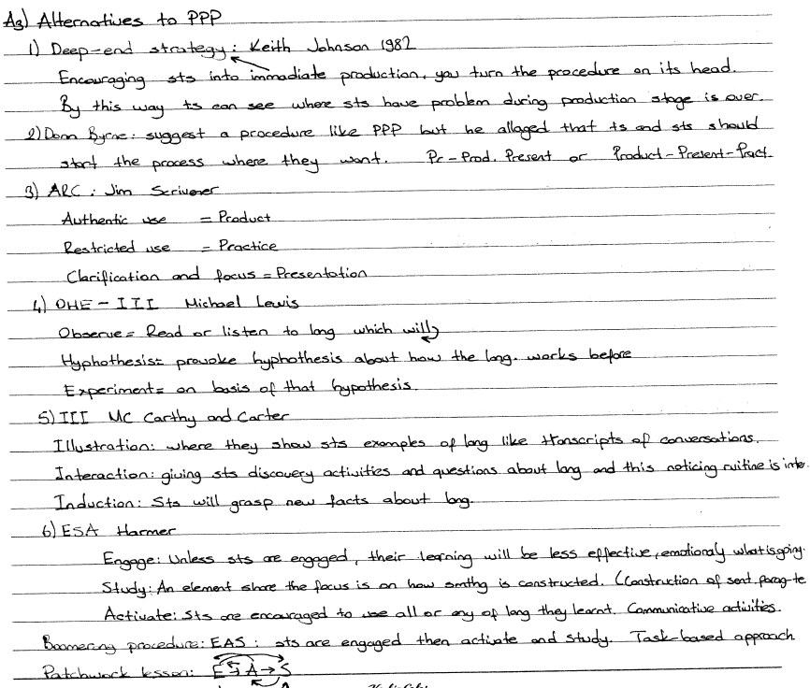

Slide 23
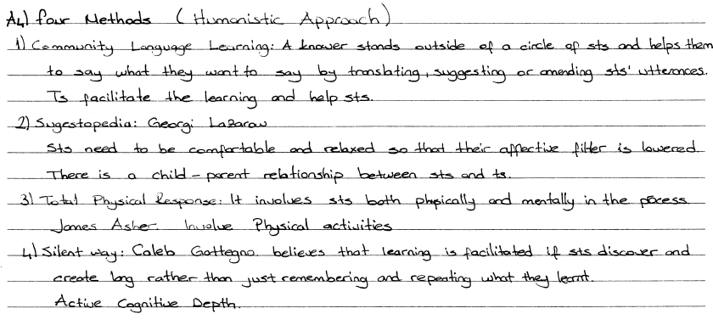

Slide 24
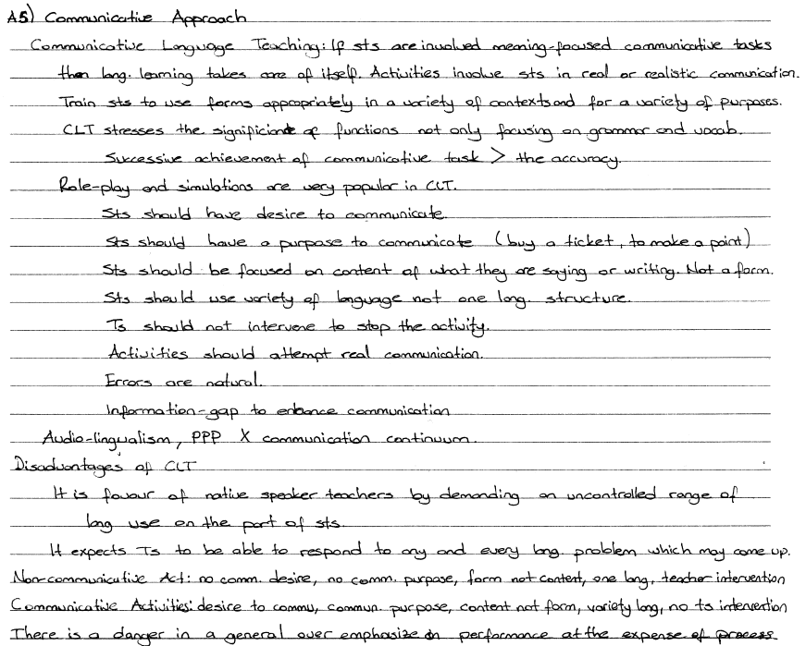

Slide 25
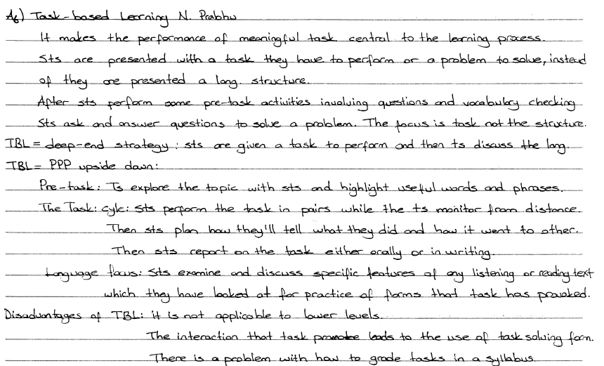

Slide 26
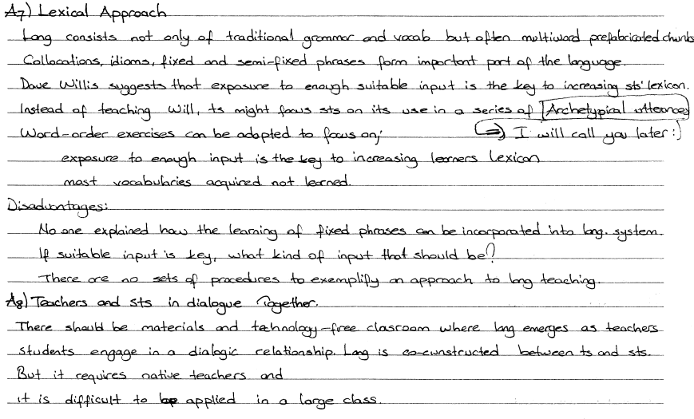

Slide 27
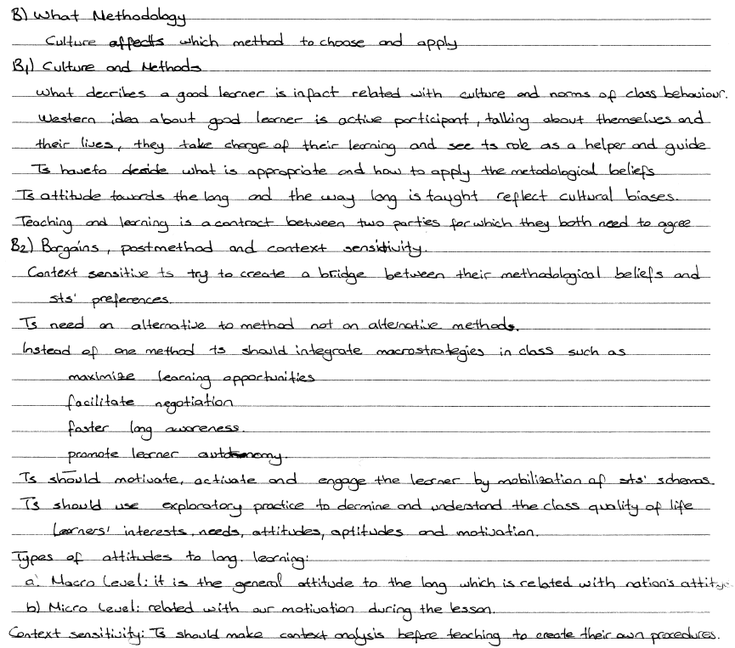

Slide 28
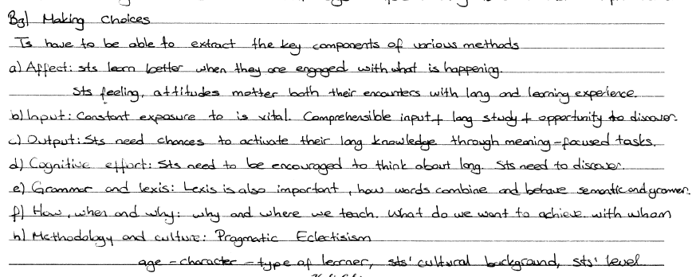

Slide 29
Unit 5 DESCRIBING LEARNERS

Slide 30
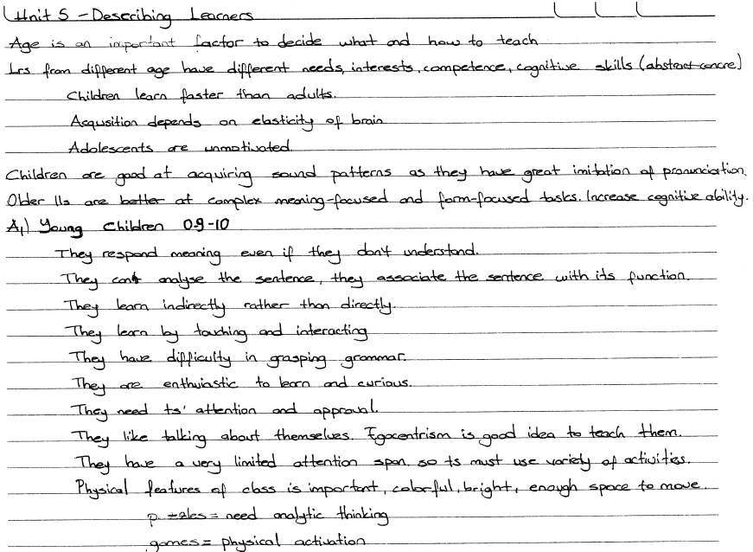
Unit 5 DESCRIBING LEARNERS

Slide 31
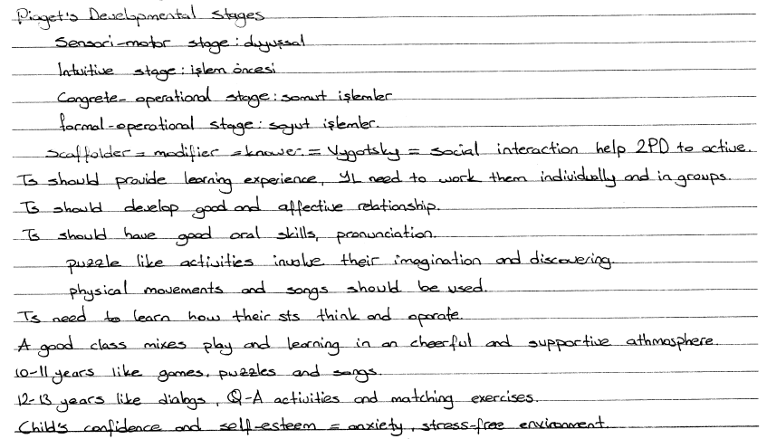

Slide 32


Slide 33
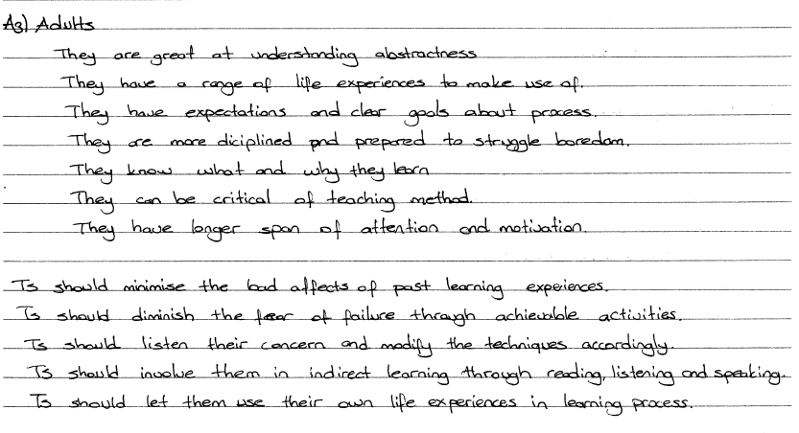

Slide 34
B. Learner differences
However we teach the group as a whole we should pay attention to different identities.
B1 Aptitude= natural tendency or ability to learn
Aptitude tests are discriminative.
They categorize people whether they have aptitude toward language or not
They measure general intellectual ability of Sts and predict their future progress.
it can not distinguish the majority of Sts
B2 Good language learner characteristics
Self-reliant autonomous, find their own way
Tolerance of ambiguity learn to live with uncertainty
Have a positive task orientation (participation) make their own opportunities
Ego involvement: want to be successful
High aspiration: have a desire to communicate, creative
Perseverance: have resistance to failure, make use of errors
Goal orientation: have external and internal goals
Use contextual clues

Slide 35
B3 Learner styles and strategies
Tony Wright described 4 different learner styles
Enthusiast: Ts are point of reference, goals of learning group are important
Oracular: focuses on the teacher but is more oriented towards the satisfaction of personal goals
Participator: tends to concentrate on group goals and group solidarity
Rebel: is mainly concerned with the satisfaction of his own goals
Keith Willing also suggest 4 learner categories
Convergers: avoid groups, independent and confident in their own abilities
Conformists: learning about the language rather than learning how to use it
Concrete learners: enjoy social aspect of learning, interested in language use and language as communication, they enjoy games and group work in class
Communicative learners: language use oriented, take risks out of class, try to operate without the guidance of teacher

Slide 36
B4 Individual Variations
People respond differently even to the same sitimuli
NLP: “preferred primary system” to experience the world;
VAKOG= visual, auditory, kinesthetic, Olfactory, Gustatory
MI theory: we don’t possess a single intelligence, but a variety of intelligences
(visual/spatial, logical/mathematical, etc.); in each person one (or more) of them is more dominant.
If sts have different predominate intelligences, and different representational systems, then the same learning task may not be appropriate for all students.
Teachers should use a variety of activities to help various types of learners.
We can try to recognize individual differences by using observations, questionnaires, or ask our students’ comments.

Slide 37
C Language Levels
Sts are described in 3 levels; beginner, intermediate and advanced
The plateau effect:
at beginner levels it is easy to see the progress, but it becomes more difficult when the students reach higher levels; this causes a plateau effect where sts consider level they have reached as enough for their needs
To avoid this effect, we should set clear goals, explain what sts need to learn, and prepare involving and interesting activities.
Methodology:
we should take our sts’ level into consideration while choosing techniques and activities
Language:
we should adjust our classroom language according to our students’ level
Topics:
topics should also be selected considering the students’ level, much complex topics would not be appropriate for low levels

Slide 38
D – Motivation
internal drive that pushes someone to do things to achieve sth.
Extrinsic Motivation = Instrumental motivation
caused by some outside factors (passing an exam, having financial reward)
Intrinsic Motivation
comes from within the individual (enjoyment of learning process itself, desire to make yourself feel better)
Sources of motivation
Society: the attitudes in the society to language learning and English language
Significant others: influence of people who are close to sts ( family members, friends )
Teacher: teacher’s attitude to the language and the task of learning is very important
Method: the way teaching and learning take place is very important for motivation
Motivation Angel
Affect: sts are motivated if they think ts care about them
Achievement: success feeds success
Attitude: sts’ confidence on their professional abilities.
Activities: meaningful, enjoyable, achievable
Agency: taking responsibility for learning

Slide 39
What to do?
Goals and goal setting:
long-term goals (passing an exam at the end of the year, having a good job in future);
short-term goals (learning something new, successful writing of a paragraph)
Long-term goals are very important but they may seem too far away to students.
If we help our sts to achieve short-term goals, this will effect their motivation positively.
Learning environment:
physical and emotional atmosphere of the class should be motivating
we can use more visual materials and music for the physical atmosphere;
we create a supportive, cooperative and encouraging class for emotional atmosphere;
our rapport with the students is also very important
Interesting classes:
provide our sts a variety of subjects and exercises to keep them engaged in class
using various techniques be helpful for creating more interesting and engaging class

Slide 40
UNIT 6 – Describing Teachers

Slide 41
UNIT 6 – Describing Teachers
A – What is a teacher?
Definitions of teachers/teaching:
actors – always on the stage
orchestral conductors – direct conversation and set the pace and the tone
gardeners – plant the seeds and then watch them grow
“teaching” means to give (someone) knowledge or to instruct or train (someone)
“teaching” means to show somebody how to do somethg or to change somebody’s ideas
Learner-centered teaching
Makes the learner’s needs and experience central to the educational process.
Sts’ needs drive the syllabus and their experiences are at the heart of course.
Measure of a good lesson is sts activity taking place, not performance of Ts.
Ts are no longer giver of knowledge, controller, and authority,
Ts are facilitators and a resources for the students to draw on

Slide 42
B - The roles of a teacher:
Controller
In charge of activities and leading from the front. Take registers, tell sts things
Organizer
Organize activities, motivate sts, make things clear
Prompter
Encourage sts to think creatively, push sts in supportive way
Participant
Join in activities
Resource
Offer guidance, encourage sts to use resource material
Tutor
Prompter+resource, pointing sts in directions
1. engage: ts get sts both cognitively and affectively involved, engaged and ready.
2. Instruct (demonstrate) Ts give necessary instruction sayin what should be done first
3. Initiate: ts initiate the activity and say how much time the sts have
4. feedback: content feedback: roles of participant and tutor form and use feedback: concerns with ts role as assessors

Slide 43
Rapport
Positive, enjoyable and respectful relationship between Sts and Ts ot viceversa
How to create rapport?
Recognizing Sts: Ts should know Sts’ names, characters, weekness, interests
Listening to Sts: Ts shoul listen individual sts’ opinions and concerns
Respecting Sts: Ts should correct or critisize any mistake constructively
Being even-handed: Ts should behave equally and aware of sts’ ID
D - The teacher as teaching aid
Mime and gesture
To convey, express and demonstrate meaning
Language model
Acting dialogues
Reading aloud (use exciting and interesting texts, encourage sts to predict what they are going to hear)
Provider of comprehensible input
Exposure to language is very important
Ss need somethg or someone to provide language that was tuned to be comprehensible
More STT than TTT (You don’t need the language practice, students do!)

Slide 44
Unit 7 Describing Learning Contexts

Slide 45
Unit 7 Describing Learning Contexts
The place and means of instruction
English is studied for many reasons. business English, EAP (English for Academic Purposes),
English for tourism, science and technology, medicine, etc.
Schools and language Schools: sts learn English in primary and secondary classroom.
Prívate language schools tend to be better equipped than some government schools.
In School and in company: the vast majority of language clases take place in educational institutions such as the schools and language schools, teachers have to be aware of School policy and conform to syllabus and curriculum decisions
Companies offer language clases and expect teachers to go to the company office of factory to teach.
Real&virtual learning environments: Internet helped to bring about new virtual learning environments in which sts can learn even they are miles away from a teacher or other classmates.
The best virtual learning sites have online tutors who interact with their sts, via email Or forums.
Some Advantages of Virtual Learning:
The student can attend lesson when they want. It no longer matters where the students are
One disadvantage of the Online learning:
The benefits of real learning environments are less easy to replicate electronically. For example: The physical reality of having teachers and get messages from their gestures, tone of voice.

Slide 46
Class Size
Some sts opt for private lesson, so teacher only has to deal with one student at a time.
However, some teachers have classes of as many as 100.
Everything depends on the particular education system that a teacher is working in.
The Techniques we use will depend to some extent on how big our classes are.
Pair work is useful for large groups, if we want to maximise individual st talking time.
In a small group everyone will have plenty of opportunities to speak during the lesson.
Having sts making mini-presentation is clearly less stressful for them in small groups.
B1- Teaching One-to-One:
One-to-one teaching is ideal for students who cannot fit into normal school schedules.
Both, Ts and sts can tailor course to exactly what is appropriate for sts.
Advantages of the teaching One-to-One:
The designing of a specific program of study.
The use of the student’s learning style and what kind of stimulus are the correct ones.
One-to-One students get greatly enhanced feedback from their teachers
Changing an activity presents less of a problem with one student than with 30.
Disadvantages of Teaching One-to-One:
Some teachers find individual students difficult to deal with.
As they don’t like them much and same can be true of a st’s feelings towards the teacher.
One-to-one learning demands more from the student as it does from the teacher.

Slide 47
One to one teaching guidelines
Make a good impression:
First impression is important when teaching one-to-one. Appearance and how we behave in lesson
Be well-prepared:
creating a good impression is to show the student that we are well-prepared
It guide us to what we are going to do, we must be alert to what happens and respond accordingly,
if sts see that we well-prepared and with a range of possible activities this will boots confidence”
Be Flexible:
One-to-one lessons provide enormous opportunities.
If a student is beginning to get tired, for example, it is not difficult to suggest a two-minute break.
If a planned topic is failing to arouse the st’s interest, it is relatively easy to switch to something else.
Adapt to the Student:
we can adapt what we do to suit a particular student’s preferences and learning style.
Listen and watch:
we are extremely observant about how sts respond to different activities, style and content.
Ts need to listen as much as they talk, indeed balance should always be in favor of listening.
Give explanations and guidelines:
explain what is going to happen, how the student can contribute to the program they are involve in.
lay down guidelines about what they can expect the Ts to do and be, and what Ts expects of them.
Don’t be afraid to say no:
One-to-one teachers should not be afraid to say no in some situations.
When Sts’ demands are excessive and say that we cannot do everything they are asking for.

Slide 48
B2- Large Classes
there are enough sts to get interaction, and a rich variety of human resources.
There are a number of key elements in successful large-group teaching:
Be organized:
Establish Routines:
Maximize individual work:
Use students:
Use worksheets:
Use pair work and group work:
Use chorus reaction:
Take account of vision and acoustics:
Use the size of the group to your advantage:
Use a different pace for different activities:

Slide 49
C- Managing mixed ability
Mixed-ability classes appear to make of planning in lessons extremely difficult.
Ts try to make this situation manageable by giving students placements test.
C1- working with different content:
Provide with different material, tailoring what wegive them to their individual needs.
C2-Different student actions:
If not offer different materials, get them to do different things in response to content
Give students different tasks:
ask all sts to look at the same reading text, but make a difference in terms of the task
Give students different roles:
We can give students different roles.
Reward early finishers:
We need to offer such sts extension tasks to reward their efforts and challenge them
Encourage different student responses:
We can give students the same tasks, but expect different student’s responses.
Identify Student Strengths (Linguistic or non-linguistic):
allow students to show off other talents they have.

Slide 50
C3- What the teacher does:
Put students in different sub-groups depending on their different abilities.
Whether we work whole class, smaller group, individuals, treat different sts differently
Responding to students:
respond to sts, giving feedback, or acting as a resource or tutor.
Being inclusive:
The skill of a mixed-ability teacher is to draw all of the students into the lesson.
Flexible groupings:
We can group students flexibly for a number of tasks.
C4- Realistic Mixed-Ability Teaching:
In ideal class we have time and opportunity to work with individuals as individuals.
However, this is extremely difficult in large classes and especially problematic
when the Ts see different groups, during the same day, just for a moment.
Also, there are times when we want to teach the class as a whole.
training and encouragement of autonomy is the ultimate achievement of differentiation.

Slide 51
D- Monolingual, bilingual and multilingual
how and when to use the L₁ in class has become the main subject for debate.
D1- Foreign-language students and their first language:
There are some powerful arguments in favor of English-only classroom.
if English is the medium sts will be provoked into more and more communication attempts,
Whether we like it or not, sts are going to be operating both in their NL and in TL
They may use L₁ in class to communicate, or translate what they are learning in mind
D2- The Benefits of Using The L₁ in The L₂ Classroom:
There are many occasions when using the student’s L₁ in the classroom has obvious advantages,
If we want to explain things, help sts with learner training or discuss matters personally with them
There is clearly a lot to be gained from a comparison between the L₁ and the L_{2.}
Students will make these comparisons anyway, so we may as well help them do it more effectively.
Translation can be a very good way of reviewing how well sts have understood grammar and lexis
D3- The Disadvantages of Using The L₁ in The L₂ Classroom:
There are problems with an unquestioning use of the students’ L₁ in the L₂ classroom,
just as there were with the idea of a total ban on its appearance.
The first is tha Ts may not always share the sts’ L₁ in the classroom.
The use of the students’ L₁ restricts the students’ exposure to English,
but reduces their exposure to a type of English that is “an ideal source of lang for sts acquisition”.

Slide 52
D4- Taking a Stand:
Conclusions about how and when to use (or allow use of) sts L₁ in the class:
Acknowledge the L₁:
we can show understanding of learning process and discuss L₁ and L₂ issues with class.
Use appropriate L₁, L₂ activities:
The activities which maximise the benefits of using the students’ L_{1.}
These include contrasting grammar, vocabulary, pronunciation or discourse.
Differentiate between levels:
The more they work in English the better their English will get
We want to make comparisons between L₁ and L₂ and encourage fifth skill” translation.
Agree clear guidelines:
Students need to know when mother-tongue use is productive and when it is not.
Ts over-use sts’ L₁, often unintentionally, but if we agree clear guidelines with the class,
we should follow them ourselves if we want our students to adhere to them.
Use encouragement and persuasion:
Teachers spend a lot of time saying to their students, during speaking activities:
If such encouragement doesn't work, stop activity and explain that, since activity is designed to practice in English, it makes little sense if they do it in another language

Slide 53
8 – Mistakes and Feedback

Slide 54
Feedback:
Assessing sts to see how they have done
Correcting mistakes
A – Students make mistakes
We can divide mistakes into three categories:
slips: self-corrected when sts notify
sts can correct themselves once the mistake occurs
errors: most dangerous ones
sts cannot correct themselves, and which needs explanation
attempts:
sts try to say sthg but don’t know correct form of saying it
There are two main causes of the errors:
L1 interference
at the level of sounds, grammar, word usage
Developmental errors
over-generalisation
They are part of natural acqusition process (Interlanguage )
Ts should provide feedback to ease reconstructing process

Slide 55
B – Assessing student performance
Teachers assessing students
Both explicit and implicit assessment can be used to assess sts’ performance
assessment is either positive or negative it is interpreted as praise vs criticism
Praise is important for our sts but to be effective, Ts should show real interest
Ts should not overcompliments
when Ts dont agree with sts self assessment This cause counter-productive
Sts need to understand reasons for Ts approval and disapproval
Punishment is counter-productive. Appropriate dosage of praise-disapproval
Feedback shouldn’t focus on lang which sts use, It should focus on the content
There are a number of ways which we can assess our students’ work:
Comments: spoken or written. Saying good or nodding is positive assessment
marks and grades: grading system should be told to sts. Clear criteria is effective
Reports: they indicate how well sts have mastered through the study period.
Those techniques should be in balance and mention sts’ weak and strong points equally.

Slide 56
Students assessing themselves
Sts assess themselves through monitoring and judging their own performance. LEARNER AUTONOMY
If we help our students to develop the awareness of their own performance, we may enhance learning
We can have our students assess themselves; they generally have a clear idea of how well they are going
In order to help our students to assess themselves
we can simply ask them, at the end of an activity or a lesson, how well they think they have got on
we can provide some materials to guide them in making their own judgments
we can formalize assessment dialogues
Informal self assessment: a piece of written comment giving themselves grades and marks.
Formal assessment: a guide or checklist a performance assessment and ROA Recording Of Achievement

Slide 57
C – Feedback during oral work
Non-communicative activity = focus on correctness = correct sts’ mistakes
Communicative activity = focus on fluency
Correction should be done in a non-threatining way and in appropriate frequency
Feedback during accuracy work
Correction is usually made up of two distinct stages.
In the first stage teachers show students that a mistake has been made Self Correction
In the second, they help the students to do something about it.
Showing incorrectness
Repeating: we can ask the student to repeat what he has said
Echoing: we repeat what the student has said by emphasizing the wrong part
Statement and question: we can indicate that something is wrong
Expression: facial expressions and gestures can be used to indicate that there is mistake
Hinting: Ts can give a quiet hint (using metalanguage) to indicate the problematic part
Reformulation: we can repeat the problematic part correctly
Getting it right:
if the student is unable to correct himself, Ts can tell the correct version explicitly
Ts focus on the correct version in detail, overemphasize the mistake
Ts provide correct form and, if necessary Ts can explain the grammar or a lexical issue
Peer Correction
Student to student correction can also be used especially in cooperative classes,
yet we should avoid making the error-making student feel belittled

Slide 58
Feedback during fluency work
Ts tolerance of error in fluency activities is greater than more controlled activities.
Ts rarely intervene during fluency activities; sometimes wait untill activity is over
Gentle correction:
if communication breaks down completely during activity, we have to intervene
While intervening we do it gently and we don’t move on to a ‘getting it right’ stage;
our intervention is less disruptive than a more accuracy-based procedure would be
We can use way of reformulation or we can use techniques of showing incorrectness
However, over-use of it will be counter-productive
Recording mistakes:
instead of intervening during an activity, we prefer to provide feedback after the activity
Since it is difficult to remember what students have said,
we can prefer writing down points we want to refer to later.
Using a chart to take our notes can be helpful (example on p:108)
We can also record students’ language performance on audio or videotape
After the event:
we can provide feedback after an activity by using the notes we took during the activity;
there are a number of ways of doing this:
we can give a general assessment of the activity
we can put some of the mistakes on the board and correct them with students
we can write both correct and incorrect forms and have sts decide which one is correct
we can write individual notes to students
While providing feedback after event, we should avoid saying who made the mistake

Slide 59
D – Feedback on written work
While providing feedback on written work
we shouldn’t focus on only the grammatical mistakes,
we should also provide feedback on the content of the written work
The amount of feedback we provide is also very important,
too much feedback would discourage whereas too little would not be useful
The feedback process would be completed once sts have made the necessary changes
because the aim of feedback is both helping and teaching
Responding
Responding to sts’ work in the course of creative work.
Giving developmental feedback on how to improve to first draft.
It takes time and can be used effectively when sts go back to produce new version
Reformulating is useful when construction problems are pointed out
Coding
Less threatening and consistent. Focus on avoiding over correction.
One element of writing “spelling, word form, paragraph constructing.”
Ts tell on a which points he will focus when correcting
Sts pay close attention to that particular point.

Slide 60
In learning environment Ts ultimate goal is to have successful class.
Sometimes Sts are out of control “disruptive talking, sleeping, poor attendance, do not homework, cheating, unwilling to speak, insulting others”
Ts first must define the problem. What is the problem?
Then Ts take precautions.
Then Ts search WHY the problems occur?
What problem behavior is?
What we should do?
How to deal with these problems?

Slide 61
Why problems occur?
Sts’ reactions to their teachers behavior
Other factors in the classroom
From outside factors
Family: having difficult home situations
Education: unpleasant experiences
Self-esteem: lack of respect from teacher or peers
Boredom: losing engagement with a task or topic
External factors: tiredness, temperature, discomfort, noise
Preventing problem behavior
prevention is more better than discipline
Creating code of conduct
Sts’ knowing where they stand
Include sts’ own opinions in the code
Teachers and students
The relationship we have with sts and maintaining sts’ interest prevent problems
Interest and enthusiasm: lesson plans must be flexible and varied.
Professionalism: Ts should know what they are doing and be respected
rapport between Ts and Sts: Ts must listen to Sts.
They are the ingredients of curing of disruptive events.

Slide 62
Reacting to problem behavior
Problem behavior should not be ignored.
Act immediately
Focus on the behavior not the pupil
Take things forward
Reprimand in private
Keep calm
Use clearly agreed sanctions
Use colleagues and institution

Slide 63
Chapter 10 – Grouping Students

Slide 64
A – Different Groups
Whole-class teaching
Advantages
It creates sense of belonging among the group members
It is suitable for activities where the teacher is controller;
it is especially good for giving explanations and instructions
Ts can have a general understanding of student progress
Sts and Ts feel secure as class is working together under authority of Ts
Disadvantages
Everyone is forced to do the same thing at the same time
Students don’t have much chance to say anything on their own
Participating in front of the whole class may bring the risk of public failure
Sts may not be encouraged to take responsibility for their own learning,
Sts don’t discover or research things for themselves
It is not the best way to organize CLT or task-based activities.

Slide 65
Students on their own
Advantages
Teachers can respond to individual differences
It is less stressful for students
It can develop learner autonomy
Classroom is less noisy and chaotic
Disadvantages
It does not encourage cooperation
It requires more effort and material preparation
Pair work
Advantages
It increases the amount of speaking time
Students work and interact independently
Teachers can work with one or two pairs while the other students continue work
Promotes cooperation and so it helps class to become a more relaxed and friendly place
It is quick and easy to organize
Disadvantages
It is very noisy and teachers worry that they will lose control
The chances of misbehavior are greater
Many sts prefer interacting with teacher rather than interacting with another student
Partners can be problematic

Slide 66
Groupwork
Advantages
It increases the amount of talking for individual students
Personal relationships are less problematic than they are in pairwork
It encourages broader skills of cooperation and negotiation than pairwork
It promotes learner autonomy
Some students can choose their level of participation more readily
Disadvantages
It can be noisy
Some students don’t enjoy it
The same students can be passive/dominant all the time
Groupwork activities may be time consuming
When to change grouping
Deciding on which grouping strategy to use will depend on:
the task
variety in a sequence: changing activity type
the mood of the students: changing grouping

Slide 67
B – Organising pairwork and groupwork
Some of our students may be reluctant to pairwork or groupwork activities.
We should try to find out how our students feel about pair or group activities
if necessary, we should spend some time for explaining what we are doing.
Creating pairs or groups
Putting sts into pairs or groups can be based on one of following principles:
Friendship: Sociograms can be used but they are time consuming, unpopular sts
Streaming: according to sts’ ability. Mixture of weak vs strong. participation
The group may change during an activity
Procedures for pairwork & groupwork
Ts roles Before pair/ group work
engage (feel sts enthusiastic), instruct (give clear instructions), initiate (giving time)
Ts role During pair/ group work
Observe, monitor sts, go round class watching and listening to specific pairs or groups,
work with some students, act as a prompter, resource and tutor.
Ts role After pair/ group work
Organize feedback,
Checking the activity and add own assessment and make corrections.
Troubles for pairwork & groupwork
Finishing first: Ts should have series of spare activities. Giving short little tasks
Awkward groups: change the group members, reorganize the group,
Chance: arbitrary thing

Slide 68
11 – Educational technology and other teaching equipment

Slide 69
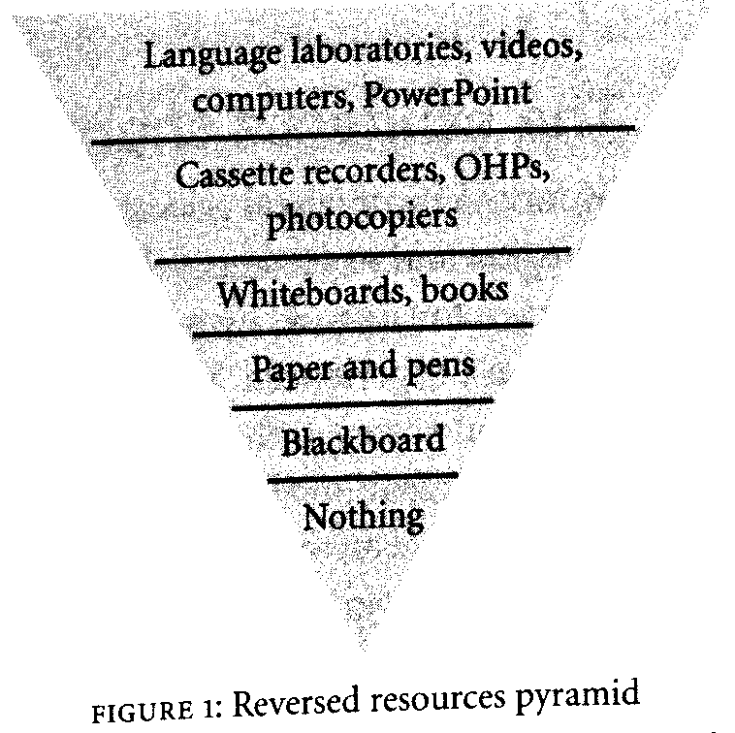
The Technology Pyramid

Slide 70
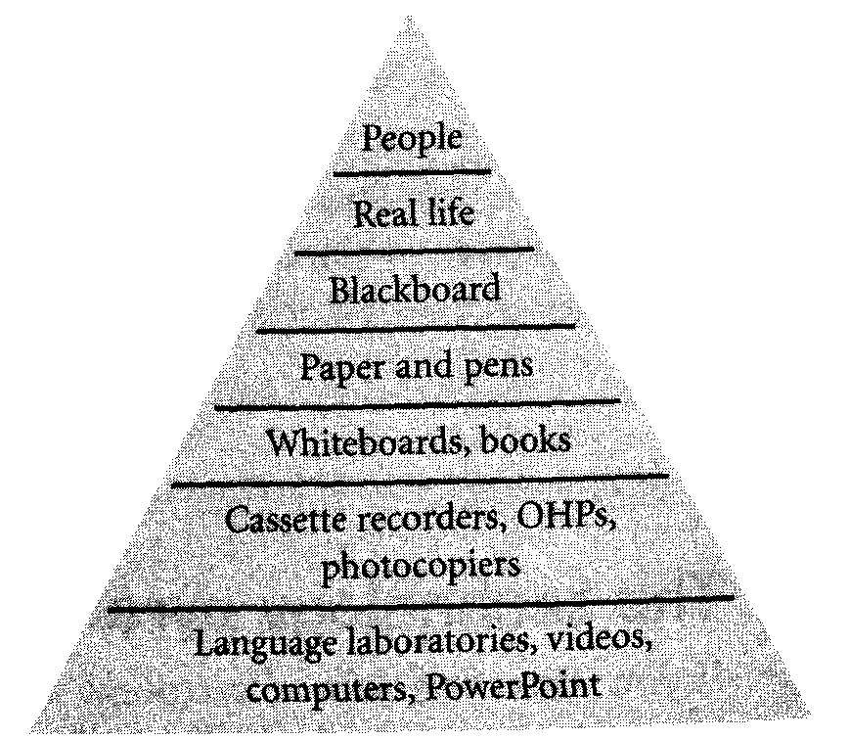
The Technology Pyramid

Slide 71
A - Pictures and images
Pictures and images we use in the classroom can be in different forms such as:
Flashcards - large wall pictures - cue cards – photographs – illustrations -
Pictures of all kinds can be used in various ways:
Drills : with lower level sts, flashcards in cue-response drills are used
Communication games: describe-draw activities, creative writing-speaking
Understanding: for the presentation and checking of meaning
Ornamentation: pics enhanced text
Prediction: getting students to predict what is coming next
Discussion: creating some discussion topics by the help of pictures
While choosing pictures to use in the class we should consider three qualities
1. they should be appropriate for the purpose and the class
2. they should be visible, big enough so that all the students can see the details
3. they should be durable, used again and again
projected slides - images from an OHP - projected PC images - self-drawn pictures

Slide 72
B – The OHP
By using OHTs you can present the items step by step
we gradually build up a complex picture, diagram or text
We can put a text with blanks and have sts complete it by using their OHP pens
Groups may use OHP for presenting their findings to the class
C – The board
We can use boards for a variety of different purposes such as:
note pad: write things up during lesson, emphasize necessary parts by underlining
explanation aid: use board while explaining sthing to make it more understandable
picture frame: draw pictures to help sts to understand concepts and words better
public workshop: activities can be done on board with participation of whole class
game board: different games can be played with the help of the board
Notice board: pictures, posters, announcements, etc. can be shared with board
Handwriting on the board should be clear and visible
We divide board into different areas for different purposes (new words, date, example
We shouldn’t turn our back to the class while writing on the board
We should try to involve the sts in the board work as much as possible
We should clean the board while we are leaving the classroom

Slide 73
D – Bits and pieces
1. Realia: real or life-like items
Useful for teaching meanings of words.
Limitations of the objects that Ts bring the class
The size and quantity of objects themselves
The sts’ tolerance (sts think childish)
2. Language cards
Posters: have notes about language.
Cards: useful for matching activities.
3. Cuisenaire rods
Small blocks of wood of different lenghts and colors
They can be used to tell a story by putting them together
They can be used to show word stress
To teach prepositions, colors, comparatives and superlatives

Slide 74
E – The language laboratory
It has 10-20 booths, each equipped with a tape deck, headphones, microphone
Sts can work on their, can be paired or grouped with others, can interact with Ts
Ts provide same material to each booth, or have sts work with different material
Sts can interact with each other, and written texts can be sent to each computer screen
The three special characteristics of language laboratories are:
double track teacher access different modes
Advantages
comparing privacy individual attention learner training learner motivation
Activities
repetition drills speaking pairing, double-plugging, and telephoning
parallel speaking Listening reading writing and correcting writing
F – What computers are for
Computers can be used in language teaching for the following purposes:
reference: CD-ROM encyclopedias, CD-ROM dictionaries, internet (search engines)
Teaching-testing programs: software packages, accompanying materials, web-sites
e-mail: easy access to people , attaching documents
web-sites: have access to authentic material, newspapers, radios, online magazines
the word processors: they allow student to compose as they think

Slide 75
G – Homegrown materials
While producing homegrown materials we can follow a five-stage procedure:
Planning: deciding on
what our aims and objectives are?
What activities we want to involve the sts in?
How we want to sts to be group?
What the content of our materials should be?
Trialling: we should try out the material before using it in class
In this way we can avoid problems like ambiguities
Evaluating: we should evaluate its appropriacy,
redesign it if necessary
Classifying: store and classify our homegrown materials
Record-keeping: keep a record of what materials we have used,
what the evaluations are

Slide 76
CHAPTER 12 – TEACHING LANGUAGE CONSTRUCTION

Slide 77
The goal of this study is to increase knowledge of language system
Studying structure and use
A focus on the structure and use of language forms;
Morphology, syntax, clauses and sentences, vocabulary
meaning and functions that phrases and sentences can convey, Pronunciation, Spelling
A1. Language study in lesson sequences
The status of language study depends on why and when it occurs.
Where the study activity should be placed in the sequence?
Should the focus on forms take place before, during or after the performance of a communicative task or a receptive skills activity?
One approach is for students to study language in variety ways,
explore a topic and then use what they have learnt to perform a task.
Alternatively, it may happen during a task-based sequence.
A third option is to study forms after the students have performed the task.
Opportunistic study may happen because a student wants to know how some elementof language is constructed or why it is constructed as it is.
Opportunistic teaching – studying language which suddenly “comes up”.
PPP encourage sts to discover or notice language before we ask them to use it

Slide 78
A2. Choosing study activities
Following planning principles:
we need to bear general planning principles in mind and offer a varied exercises
Sts have different learning styles, and we help them sustain their motivation.
Assessing a language study activity for use in class:
how effective it will be,
it should justify the time we will need to spend on it both before and during lesson,
does the activity demonstrate meaning and use clearly and that it allow opportunities,
we have to be confident that it will engage our learners successfully.
One way of assessing activities is to judge efficiency and their appropriacy.
The terms of efficiency; economy, time and efficacy;
economy means time; an easy activity is one that is simple for Ts to use and organize;
an efficacious activity is one that works.
In terms of appropriacy, we need to judge
whether the activity is suitable for the time of day,
Evaluating a study activity after use in class:
answers questions such as
whether or not the exercise helped students to learn the new language(efficacy),
whether students were engaged by it(appropriacy)
whether or not we want to use it again (or modify for the next use).

Slide 79
A3. Known or unknown language?
Individual sts learn at different speeds and in different ways.
These two facts, taken together, it means “mixed ability”.
If we are not sure whether or not our sts know the language
we are about to ask them to study,
we will need to find this information out.
If we don’t,
we risk teaching sts things they already know
or assuming knowledge they do not have.
One way of avoiding teaching already known language is
to have sts perform task,
attempting to elicit the new language forms.

Slide 80
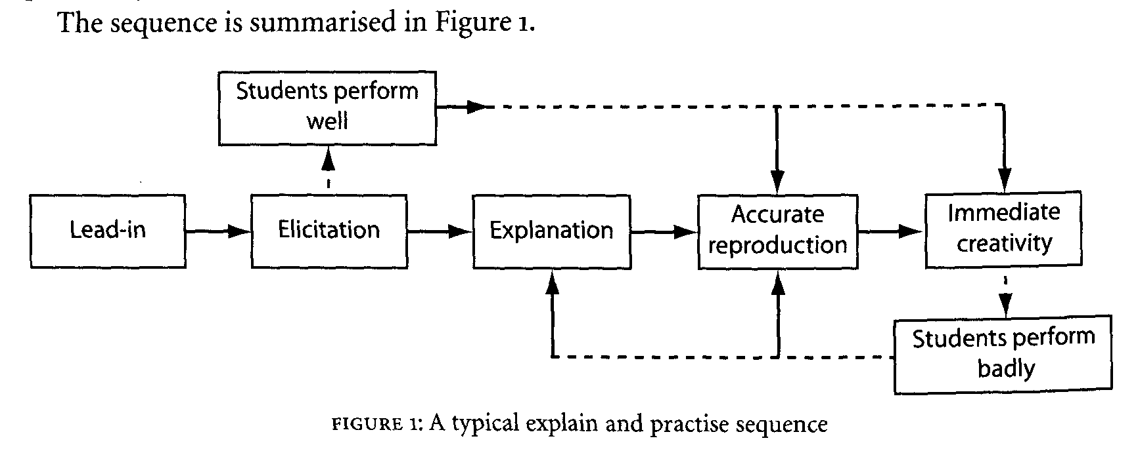
B. Explain and practice
Commentators described “explain and practice” approach as a deductive;
sts are given explanations or grammar rules and then,
based on rules, they make phrases and sentences using new language
An activate (immediate creativity) stage where the sts try to make their own sentences.
Sts will involve in some repetition, repeat sentences in chorus, cue-response drilling.
All of this stage is designed to foster accurate reproduction of what Ts are introducing.

Slide 81
B1. Explaining Things
Explaining meaning:
ways of explaining the meaning;
showing it, for actions we can use mime or gesture,
we can demonstrate superlative adjectives by using hand and arm movements,
many teachers have standard gestures to explain,
we can also use facial expressions, pictures, diagrams, time lines,
we can describe the meaning of word,
we can list vocabulary items to explain concepts,
we can use check questions, and translating words and phrases.
Explaining language construction:
through modeling sentences and phrases.
Many teachers use fingers or hands.
We can also demonstrate word - sentence stress by beating time with our arms.
We can show intonation patterns by “drawing” the tune in the air,
diagrams on boards or overhead projectors,
writing words on individual cards,
Cuisenaire rods (show parts of speech, stress patterns, sentence construction).

Slide 82
B2. Practice (accurate reproduction)
Repetition: can be either choral or individual.
For choral repetition to be effective; start the chorus clearly,
help sts with the rhythm by conducting with your arms and hands.
Choral repetition can be invigorating because it gives all sts a chance to speak together.
Sometimes teachers divide the class in half (semi-chorus).
We may ask for individual repetition, after chorus, by nominating,
be careful not to nominate sts in obvious order, will not keep sts on their toes.
In individual repetition, sts to say word or phrase quietly to themselves,
murmuring it a few times as they get used to saying it.
Drills: we may organize a quick cue-response session to encourage controlled practice of the new language.
We can use cards as cue.
Cues can be also verbal or non-verbal.
If we think students need more controlled practice, we can put them in pairs
ask them to continue saying the new words or phrases to each other.

Slide 83
C. Discover (and practice)
Inductive approach,
sts see examples of language and try to work out how it is put together.
If we want sts to understand how speakers use certain phrases as delaying tactics
we might get them to listen again.
Discovery activities are especially useful
when sts are looking at construction of specific language for second or third time.
If sts do not like inductive approach, they would prefer to be “spoon fed”.
Detective work is intended to expand their knowledge and revise things they are already familiar with.
D. Research (and practice)
We could ask them to consult a dictionary
or encourage them to use search engines, such as Google.
When sts research language, they are far more likely to remember what they find out
than if they sit passively and are given words (affective at higher levels).
we may ask them to use the language they have discovered (like discovery activities).
Over-drilling can have a very demotivating effect

Slide 84
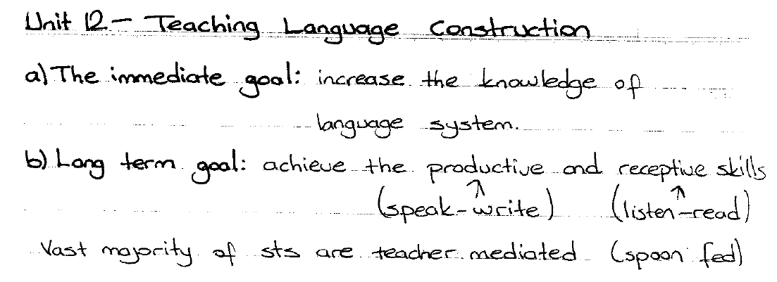

Slide 85
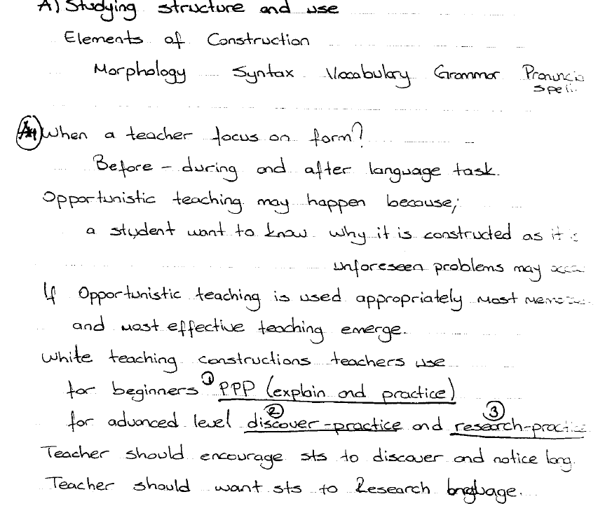

Slide 86
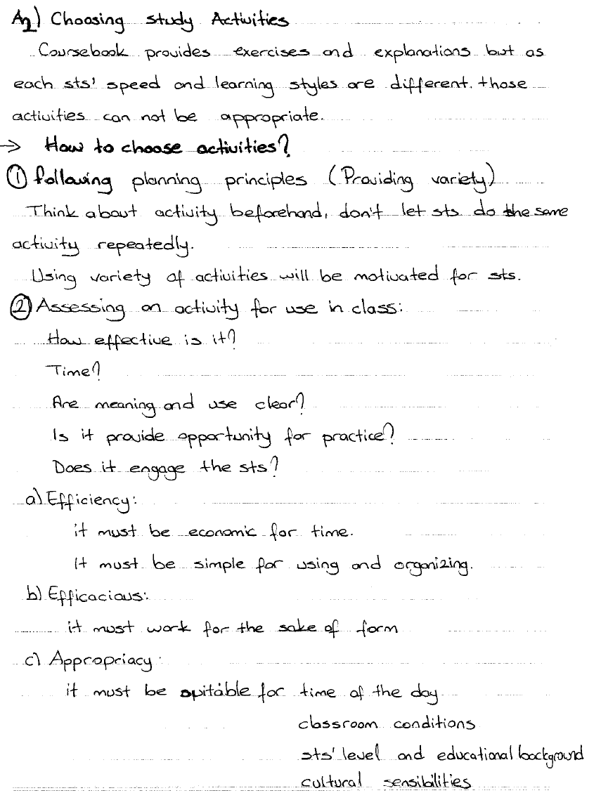

Slide 87
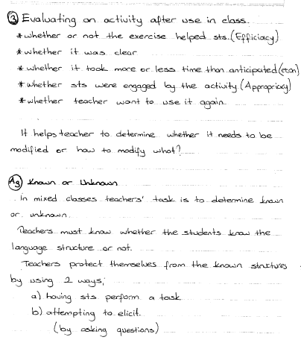

Slide 88
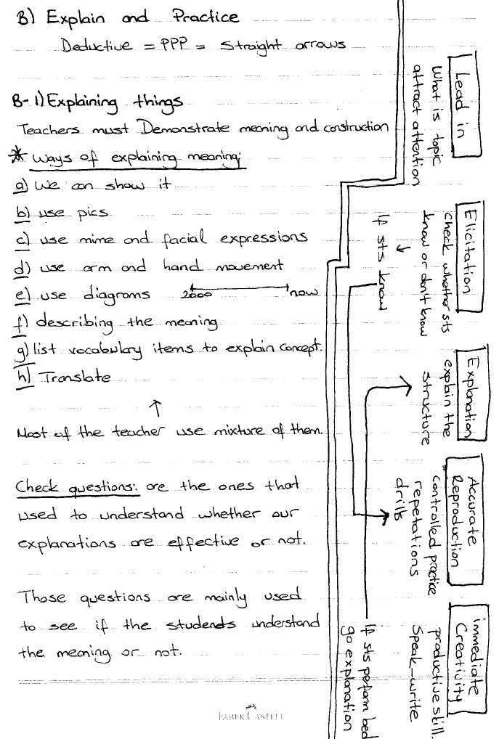

Slide 89
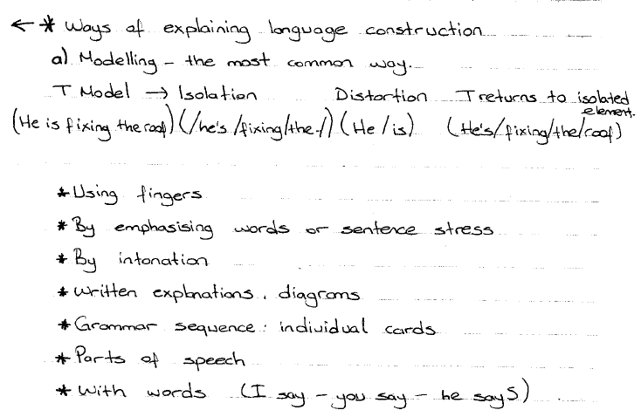

Slide 90
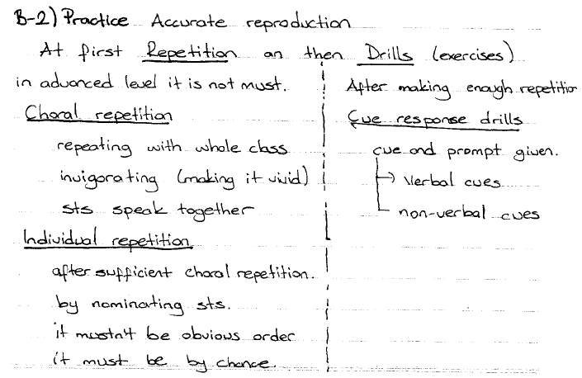

Slide 91
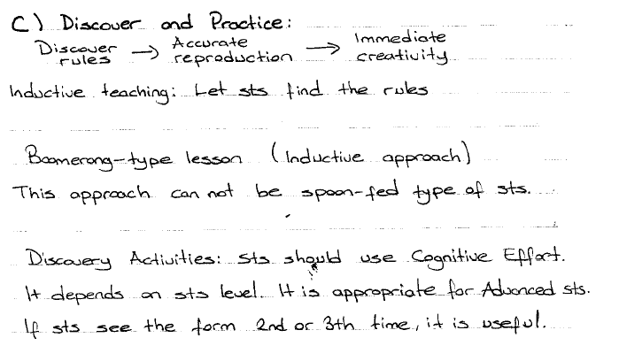

Slide 92
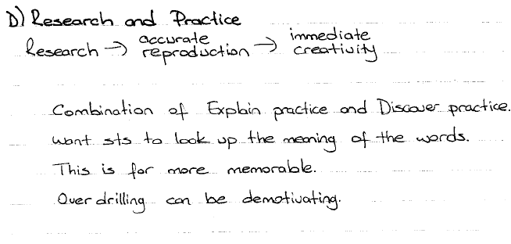

Slide 93
Unıt 13 teaching grammar

Slide 94
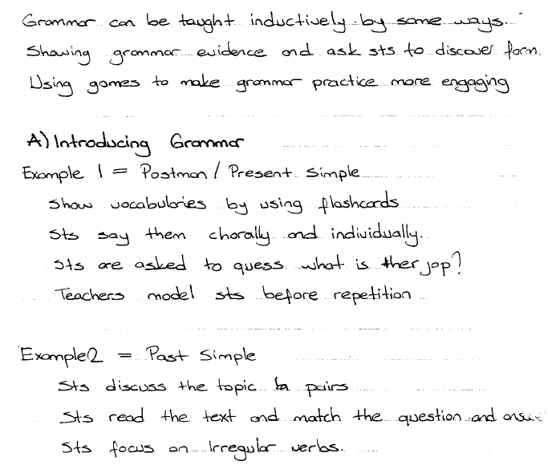

Slide 95
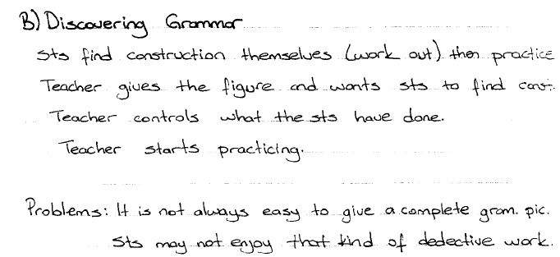
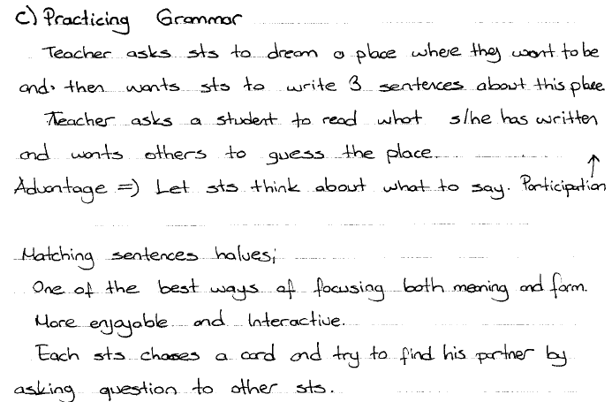

Slide 96
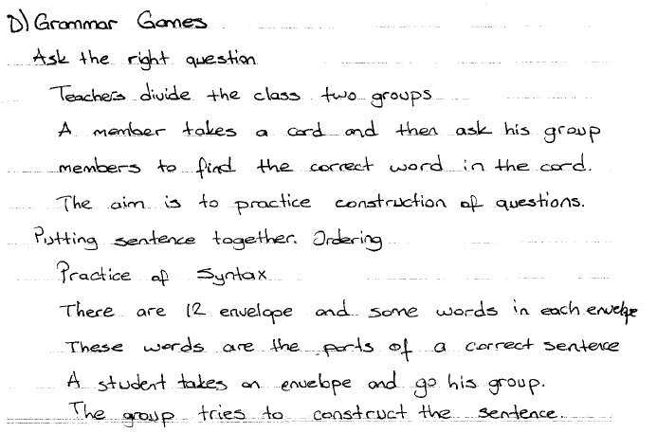

Slide 97
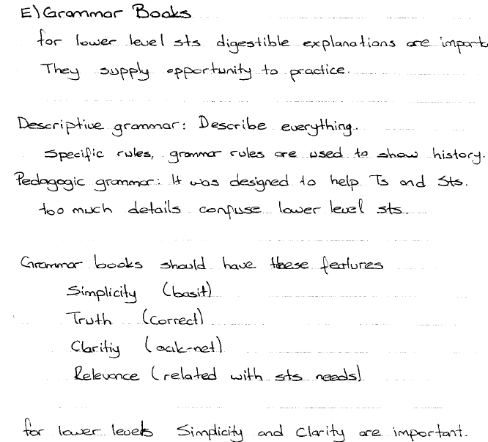

Slide 98
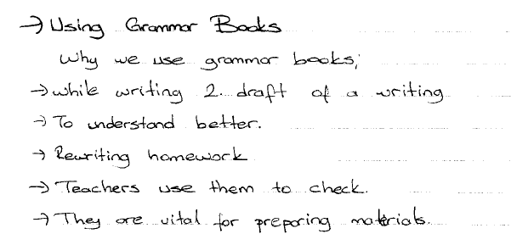

Slide 99
Unit 14 teaching vocabulary

Slide 100
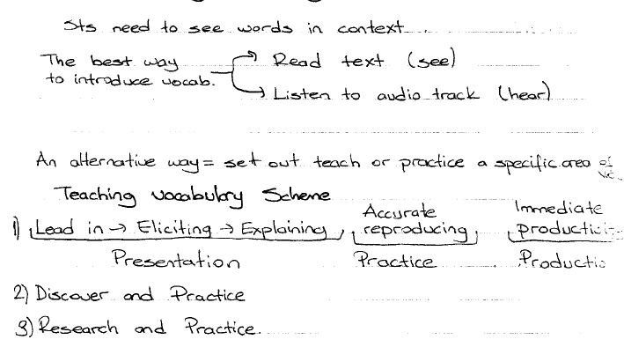

Slide 101
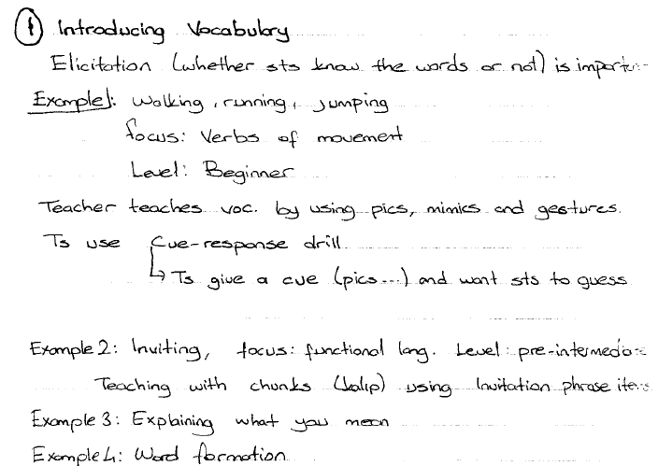

Slide 102
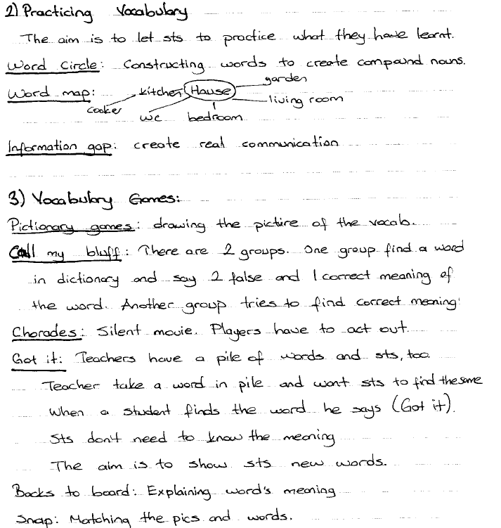

Slide 103
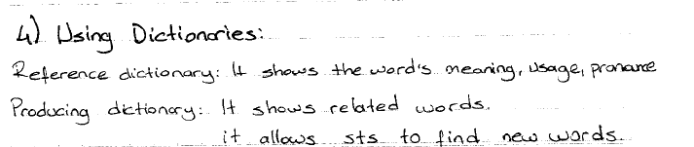
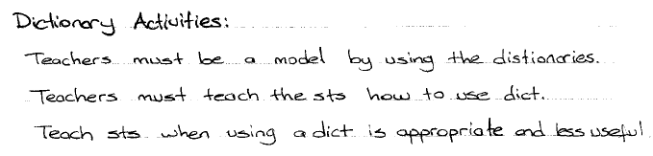

Slide 104
Unit 15 teaching pronuncuation

Slide 105
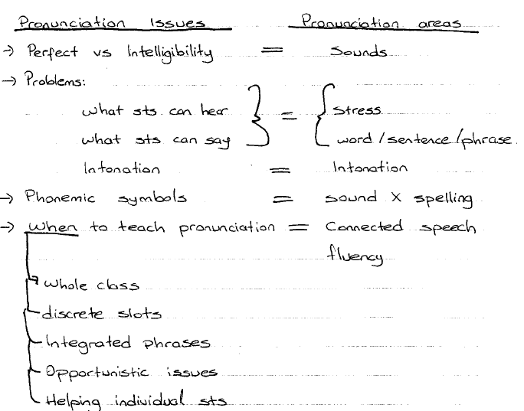

Slide 106
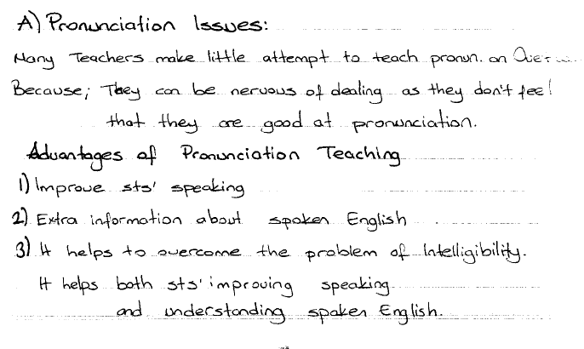

Slide 107
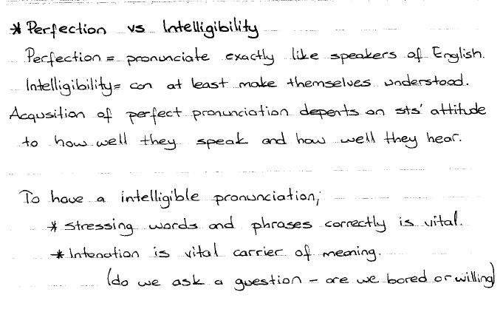

Slide 108


Slide 109


Slide 110


Slide 111


Slide 112


Slide 113


Slide 114


Slide 115
Unit 21 Planning Lesson

Slide 116
A. The Planning Paradox
David Mallows, what happens in a lesson is result of an interactive system that is extremely complex.
As lesson progress, things evolve and develop,
depending on what has happened and what is happening minute by minute.
It makes no sense to go into any situation without having thought about what we are going to do.
Yet at the same time, if we pre-determine what is going to happen before it has taken place,
we may be in danger not only of missing what is right in front of us
but, more importantly, we may also be closing off avenues of possible evolution and development.
New teachers, especially, need maps to help them through the landscape.
And students, too, lie to know what their teacher has in store for them.
Evidence of teacher planning helps to ensure their confidence in the person who is teaching them.

Slide 117
A1. The planning continuum
Jungle path
teachers walk into class with no real idea of what they are going to do
Follow the coursebook exactly
teachers do exactly what the book says
Vague (corridor) plan
TS make actual decisions about what to do while they are going to class
Planning notes
Ts may informally write things in their notebooks, take notes on their book
Formal plan
Ts write formal plans which detail what they are going to do and why
Written plans act as a useful record of what we hoped to achieve,
and where we amend these records to say what actually happened,
they become effective accounts which we can use for action research.
JUNGLE PATH VAGUE (CORRIDOR) PLAN FORMAL PLAN
0% 100%

Slide 118
A2. Using plans in class
Sometimes we need to modify our plans while lesson is taking place.
There are some reasons why we need to modify our plans:
magic moments
when a conversation develops unexpectedly, a topic produces unpredicted interest
sensible diversion:
when sthng happens which we simply can not ignore ( opportunistic teaching)
unforeseen problems:
when sts find activities boring,
It is in the implementation and adaptation of a plan – and the interaction between the plan and ever-changing reality once a lesson has started – that the planning paradox is ultimately resolved.

Slide 119
B. Pre-planning and planning
The pre-planning stage is where we gather ideas and material and possible starting-off points.
The pre-planning stage is the start of the whole progress.
Ideas for pre-planning can come from a wide variety of sources.
Ex: a good activity to use, something on the internet or on the TV, particular item of language, and vague idea about working on a unit of our coursebook.
Pre-planning ideas are usually based on our knowledge of who we are teaching, their personalities, their level and syllabus.

Slide 120
B1. Student needs
Plans are based both on syllabus and on perceptions of needs and wants of sts.
We can do this by asking the sts what they want or expect from the lessons
modifying what we had intended to teach accordingly.
Ways of constructing a need analysis:
we can talk to Sts
we can give sts lists of possible activities or topics
we can ask sts to write to us and tell us what they need,
We can give sts statements about course for them to modify
we can administer questionnaires before, during and after the course

Slide 121
B2. Making the plan
In the per-planning phase we have considered a number of different parameters.
In the first place, we are familiar with the syllabus and, based on its requirements,
we have a number of activities and topics floating around in our heads.
We have learnt about our students and the time table, too.
We also know what equipment we can count on (OHP, data projector)
Syllabus type:
Grammatical syllabus: list of items, such as present contn, comparatives, adjs
Functional syllabus: such as apologizing, inviting etc.
Situational syllabus: at the bank, at the travel agent, at the supermarket etc.
Lexical syllabus
syllabuses based on lists of task

Slide 122
What most designers and coursebook writers try to provide is a kind of multi-syllabus syllabus,
An interlocking set of parameters for any particular level or point of study
which includes not only the categories discussed above,
but also issues of skills and pronunciation.
Grammar is seen essential syllabus frame around which other syllabuses are erected.
Lesson stages:
how one activity leads into another is a matter of how different parts or stages of a lesson hang together.
Sts need to know when one stage has finished and another is about to begin.
This involves drawing their attention to what is going to happen next, by making summarizing comments, and writing the different stages to board.

Slide 123
B3. Making the plan formal: background elements
Certain elements:
Aims:
These are the outcomes which all our teaching will try to achieve-the destinations on our map.
Aims should reflect what we hope the students will be able to do.
Many trainers used the acronym SMART to describe lesson aims,
which should be specific, measurable, achievable, realist and timed.
A lesson will often have more than one aim. Aims can be written in plans.
Class profile:
Tell us who the students are and what can be expected of them.
It can give information about how group an how the individuals in it behave.
With smaller groups it gives detail information about individual students (age, sex, job, level, info).
Assumptions:
What we assume the students know and can do.

Slide 124
Personal aims:
are those where we seek to try something out that we have never done before, or decide to try to do better at something which has eluded us before.
Skill and language focus:
what language and skills students are going to be focusing on in the aims that we detail.
Timetable fit:
where the lesson fits in a sequence of classes-what happens before and after it.
We will also include information about how the classes have been feeling and what kind of activities they have been involved in.
Potential learner problems and possible solutions:
when listing anticipated problems, it is a good idea to think ahead to possible solutions we might adopt to resolve them.
If lesson proceeds faster than we anticipated, we may need additional material anyway.
Success indicators:
trainer to list how they will know whether or not their students have been successful.
Both teacher and observer can easily evaluate if the lesson aims have been achieved.
This is often required by trainers to provoke trainers into thinking about implications of the chosen language or skills.

Slide 125
B4. Making the plan formal:
describing procedure an materials
The main body of a formal plan lists the activities and procedures in that lesson,
together with the times we expect each of them to take.
Interactions:
T=teacher, S=a student,
T→C= teacher with whole class,
S,S,S=students working on their own,
S↔S=students working in pairs,
SS↔SS= pairs with other pairs,
GG=students in groups

Slide 126
C. Planning a sequence of lessons
Reacting to what happens:
we should modify what we do based on student reactions.
We have to revisit our original series of plans continually to update and amend them
Short – and long-term goals:
When plan a sequence of lessons, we need to build in goals for both sts and ourselves
Short term goals are more motivating than long-term goals.
Thematic content:
To focus on different thematic content in each individual lesson. It will provide variety.
With such thematic threads, we and sts can refer backwards and forward,
both in terms of lang and also topics we ask them to invest time in considering.
Language planning:
we need keep a constant eye on how things are going with knowledge of “before -after”.
Our decisions about how to weave grammar and vocabulary through the lesson sequence will be heavily influenced by the need for a balance of activities.
Activity Balance:
If we get it right, it will also provide widest experience to meet different learning styles
(role-play, drilling, repetition, oral, and pairs or groups)
Skills:
many general English courses are designed to involve students in all four skills.
Different skills need to be threaded through a sequence of lessons.

Slide 127
C1. Projects and threads
We will try to ensure that a good balance of skills, language, activities and thematic strands is achieved throughout the time in which the students are working on the project (long-term).
These are the varied connections of themes, language, activities and skills which weave through the sequence like pieces of different colored thread (Short-term).
They should have sufficient variety built into them so that they are not predictable, but, at the same time, students and their teachers should e able to trace the threaded elements so that some kind of a loose pattern emerges.
Tapestry: variety and colour rather than some of the darker heavier works which can be found in old houses and museum.

Slide 128
Unit 22 Testing and Assessment

Slide 129
Testing and Assessment
Ss are tested because;
It measures the sts ability to enter a course or institution.
How well they are getting on
Sts themselves want a qualification
Assessment is sometimes formal and public, sometimes informal and in lesson.
Summative assessment
Measurement that takes place to round things off or make a one-off measurement.
Such tests include the end of year tests that ss take
or the big public exams which many ss enter for.
Formative assessment
It is feedback that ts give ss as a course is progressing
and which as a result may help them to improve their performance.
we indicate that sthg is wrong and help sts to get it right.
Both sts and ts change and develop.

Slide 130
A1)Different types of testing:
placement tests:
placing new ss in the right class, test grammar and vocab knowledge
based on syllabus and materials
assess sts’ productive and receptive skills
self- analysis into the final placing decision
diagnostic tests:
are used to expose learner difficulties, gaps in their knowledge and skill deficiencies.
So we know what problems are and what can we do for it.
Progress or achivement tests
measures learners’ lang and skill progress in relation to syllabus they have been following
They are often written by ts
Ss see how well they re doing
The materials shouldnt be the exact materials.
They have seen before but similar
Completely new material wont measure learning but measure general lang proficiency
Achievement tests at the end of the term should be reflect the progress not failure
It helps to decide on future changes

Slide 131
Profifiency tests
It gives general picture of sts’ knowledge and ability
Stages people have to reach to be admitted to somewhere
It has profound backwash effect Ex: public examinations..
Portfolio assessment
it is assessed by looking some of the best pieces of work over this period.
It provides evidence of ss efforts and It makes autonomous
Foster ss reflection and help them to self monitor their own learning
Clear validity and Exteremely positive backwash effect
On the other hand;
Time consuming
Ts need training about how to select items, grade it
We aren't sure about if they get help from others

Slide 132
A2) charasteristic of a good test
Validity:
Similar results to some other measures
Validity in the way its marked
Face validity
Reliability:
Should give consistent results
Making test instructions clear
Restricting the scope for variety in the answers
Make sure that test conditions remain constant
The scorers – Scoring of test should be as reliable as possible

Slide 133
B)Types of test items
The major purpose of test or exam in its success or failure as a good measuring instrument will be determined by the item types that it contains
B1)Direct and indirect test items
Direct
testing communicative tests , like a real life
Indirect
testing sts’ knowledge and ability (receptive and productive) like MCQ, grammar transformation.
These kinds ; quick to design, easy to mark, reliable
Discerete point: tests one thing at a time
Integrative: expect sts to use variety of language at any one given time.
Mixture of all.
asking sts to choose the correct tense of a word
Writing composition or doing a conversational oral test
.l

Slide 134
B2) Indirect test items types:
MCQ:
Known MC is ideal to measure gram & vocab. Prevents to possibility of scorer error
Problems
Exteremely difficult to write(distractors). May not improve their English(technique)
Cloze procedure
integrate test item, sts overall knowledge every nth word so avoid designer failings
Problems;
Rather than general English , tests some particular words
Several possible answers, Different passages produce different results
‘rational’ or modified cloze test are better if deleted words are recoverable from contex
Judge sts suitability for those levels, Suitable for both achivement and proficiency
Transformation and paraphrase
re-write, first understand sentence then construct equivalant grammatically.
Sentence re- ordering
knowledge of syntax and lexico-grammatical
Fill-ins
Find errors in sentence
Choose the correct tense or verb
Choose the correct form of word

Slide 135
B3) Direct Test Item Types
For direct test items to achieve 'validity' and to be 'reliable: test designers need to do the following
Create a 'level playing field‘
It needs to avoid making excessive demands on st's general or specialist knowledge.
It can also be undermined if means of testing requires sts to perform well in writing or speaking (when it is a test of reading or listening).
In such a situation we can not be sure that it is receptive skill we are measuring.
• Replicate real-life interaction
in real life when people speak or write they do so with some real purpose.
Yet traditional writing tests are based exclusively on general essay questions
Speaking tests often included hypothetical questions about what candidates might say if they happened to be in a certain situation.
Modem tests include tasks which attempt to replicate features of real life (Weir 1993: 167).
They will often look similar to the kind of speaking activities.

Slide 136
SPEAKING
• an interviewer questioning a candidate about themselves
• 'information gap' activities where a candidate has to find out information either from an interlocutor or a fellow candidate.
• 'decision-making' activities, such as showing paired candidates ten photos of people and asking them to put them in order of the best and worst dressed
• using pictures for candidates to compare and contrast, whether they can both see them or whether (as in many communication games) they have found similarities and differences without being able to look at each other's material
• role-play activities where candidates perform tasks such as introducing themselves, or ringing a theatre to book tickets
WRITING
• writing compositions and stories
• 'transactional letters' where candidates reply to a job advertisement, or pen a complaint to a hotel based on information given in the exam paper
• information leaflets about their school or a place in their town
• a set of instructions for some common task
• newspaper articles about a recent event

Slide 137
READING
• multiple choice questions to test comprehension of a text
• matching written descriptions with pictures of the items, or procedure, they describe
• transferring written information to charts, graphs, maps, etc. (though special care has to be taken not to disadvantage non-mathematically minded candidates)
• choosing the best summary of a paragraph or a whole text
• matching jumbled headings with paragraphs
• inserting sentences provided by the examiner in the correct place in the text
LISTENING
• completing charts with facts and figures from a listening text
• identifying which of a number of objects (pictures on the test paper) is being described
• identifying which (out of two or three speakers) says what
• identifying whether speakers are enthusiastic, encouraging, in disagreement, amused
• following directions on a map and identifying the correct house or place

Slide 138
C) Writing and Marking tests
C1)Writing tests:
Before designing a test there are a number of things to do;
Assess the situation
we should decide on ;how much mark, context, duration, place
Decide what to test
we have list what we want to include ,in our test.(decide which skill, syllabus..)
We dont have to test every single item but choose representative samples.
Balance the elements
decide how many direct and indirect questions, and how long each section take
Weight the score
Ss success depend on how many Marks are given to each section
Make the test work
try out test on colleagues and other ss before

Slide 139
C2)Marking items:
Training
scorers should see the examples of scripts at various different levels and discussed what Marks should be given.
For oral test discuss video.
More than one scorer
reliability- moderators
Global assessment scales
pre-defined descriptions of performance what ss need to capable of to gain required Marks
Problems;
ss may not be the exact match of scale, ts may not reach a conensus about scale
analytic profiles
ss’ performance is analyzed in detail. Not general assessment but for different elements
We can add to assessment repair strategies and task completion. For each criteria provide analytic scale
Combination of analytic and global scoring gives us the best chance of reliable marking
Test designers and administrators will have to decide how to accommodate the competing claims of reliability and practically

Slide 140


Slide 141


Slide 142


Slide 143
Chapter 23 learner autonomy

Slide 144
A – The autonomous learner
To compensate for the limits of classroom time and to encounter the passivity which is an enemy of true learning, students need to develop their own learning strategies, so that as far as possible they become autonomous learners.
Educational culture in which students have studied or are studying is very effective on students’ attitudes towards autonomy.
There are various ways that help our sts to become autonomous:
learner training: we can help our sts to reflect on the way they learn and reflect on language itself, give them different strategies which help them in their learning process, and offer them different learning-style alternatives to choose from
homework: is a useful tool to develop learner autonomy but amount of homework is very important; we should consider how much homework sts can cope with; purpose of homework should also be made clear to sts
keeping learning journals: can be helpful for developing learner autonomy as they make sts reflect on their lessons, explore their successes and difficulties, and come to a greater understanding about learning & language

Slide 145
The SAC (Self Assess Center)
In SACs sts work on their own (or in pairs, groups) with a range of material.
Sts may use SACs either as a part of the timetable or in their own spare time.
There are some factors which make SAC effective:
classification system: it should be good so that students can find anything they are looking for easily
pathways: sts should be provided suggestions about where to go after completing exercises (SAC assistant and teachers have an important role here)
training sts: students need to be trained to use centres appropriately
making SAC appropriate for students: there should be a warm and cooperative atmosphere in the SACs
keeping interest going: we should try to keep users involved and interested in the SACS – How?

Slide 146
After the course
We should give our sts help and advice about how to continue with their learning when they have stopped attending our lessons.
We can suggest them that they should stay in contact with English after the course (watching TV, reading magazines, listening to music, etc.)
We can include ‘continuing learning’ as a topic in the syllabus, and by this way we can train our students about how to continue learning after the course.
We can prepare personal study plans for individual students according to their individual needs
We can encourage.

Slide 147
Chapter 24 what Teachers do next

Slide 148
The developing teacher
Ts who want to develop themselves and their practice will benefit both their sts and themselves far more than those who gradually become less engaged with the task of language learning.
There a lot ways of achieving teacher development:
Action research
We may want to know more about our learners and ourselves as teachers
We may want to know about interest generated by certain topics
We may want to judge the effectiveness of certain activity types
Methods (of collecting data)
Keeping a journal Observation tasks Language progress
Interviews (with students and colleagues) Written questionnaires
Professional literature
We can learn a lot from the various methodology books and journals

Slide 149
Developing with colleagues
We can work with other language teachers while trying to develop our teaching skills. There are many ways teachers can confer with each other:
Cooperative/collaborative development: Ts discuss what they are doing and what happens to them, so that they can examine their beliefs and feelings (speaker-understander)
Peer teaching, peer observation: colleagues watch and teach together so that both may be helped in their understanding and practice
The teachers’ group: Ts, usually working in the same school, meet together and discuss any issues and problems which may arise in the course of their teaching
Teachers’ associations: conferences and presenting
The virtual community: Ts may share their experiences and ideas via internet
A broader view of development
Learning by learning Mind and body Supplementing teaching

Slide 150
thanks

